Slide 1
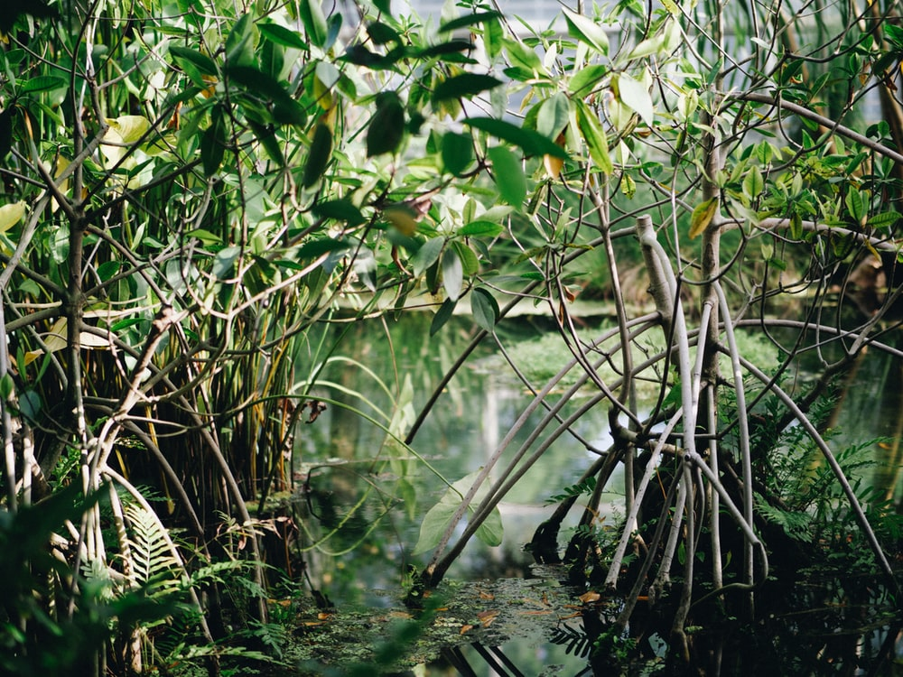
Are Mangroves in Mactan Island at Risk?
University of the Philippines Cebu
Master of Science in Environmental Studies
Geographic Information Systems
(ENS 281)
Assessing the Exposure of Mangrove Forests in Mactan Island towards Environmental Hazards
Presented by:
Mark Anthony A. Cabanlit

Slide 2
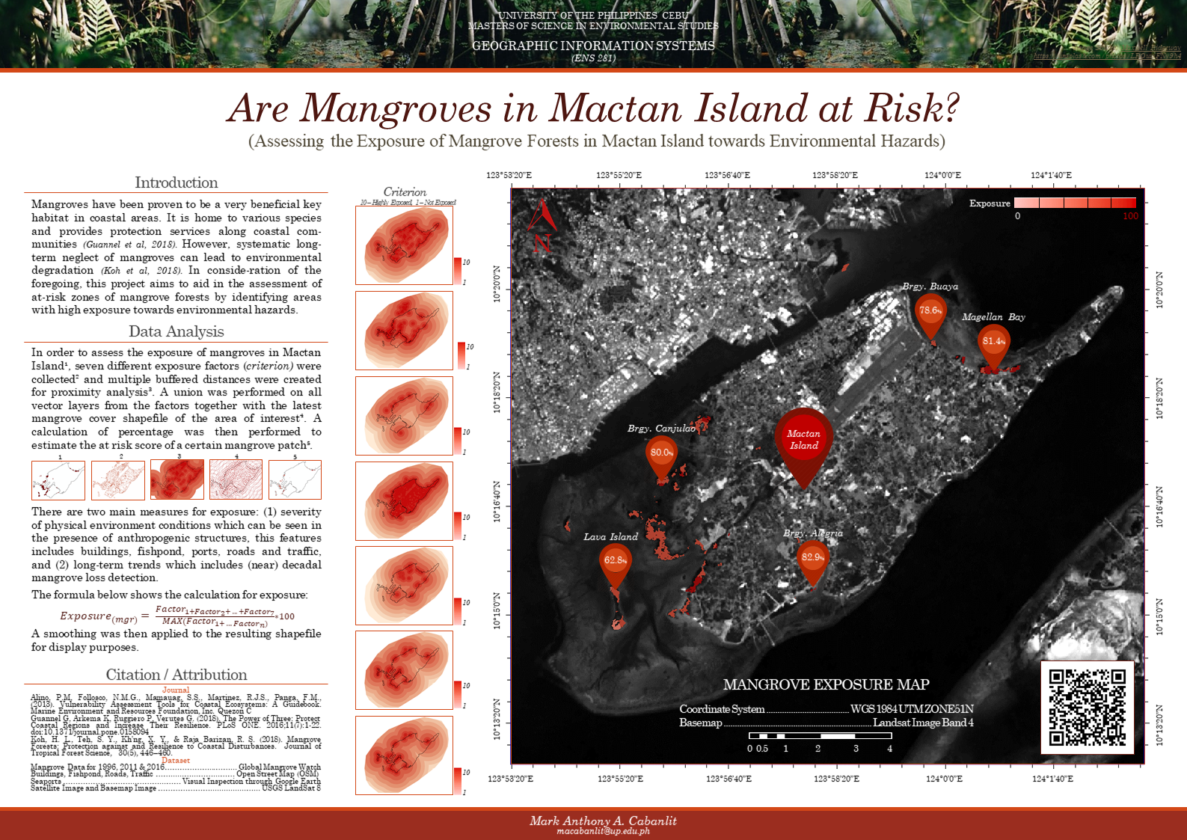
Notes:
Click image for a copy of the map.
https://drive.google.com/open?id=1VPpIOzBRfPotJhtJtl9lxUkhznxt7EcB

Slide 3
To aid in the assessment of at-risk areas of mangrove forests by identifying areas with high exposure towards environmental hazards.
MAIN OBJECTIVE

Slide 4
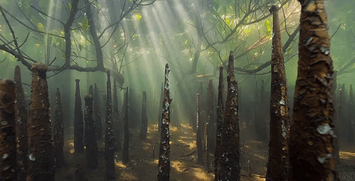
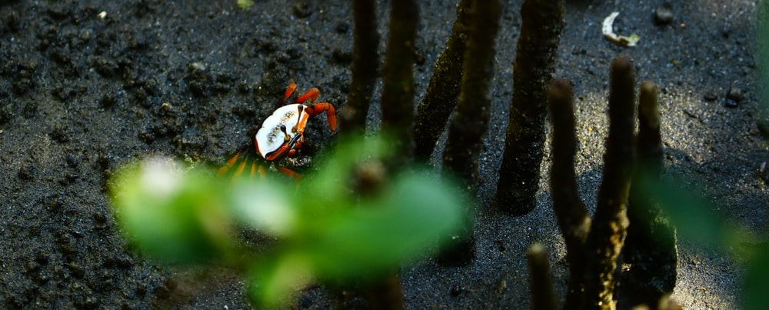
Related Literature
A Short Review on Mangroves
Notes:
Image Source
https://www.google.com/imgres?imgurl=https%3A%2F%2Fmedia3.giphy.com%2Fmedia%2Fxiqa6sF1WSxvoFzmOk%2Fgiphy.gif&imgrefurl=https%3A%2F%2Fgiphy.com%2Fexplore%2Fmangrove&docid=nh7qnHXkAQUBYM&tbnid=hIccR-1yA8R3dM%3A&vet=10ahUKEwj9sZS826blAhWOMd4KHcpgAc0QMwhdKAAwAA..i&w=480&h=246&bih=682&biw=1536&q=mangrove%20gif&ved=0ahUKEwj9sZS826blAhWOMd4KHcpgAc0QMwhdKAAwAA&iact=mrc&uact=8

Slide 5
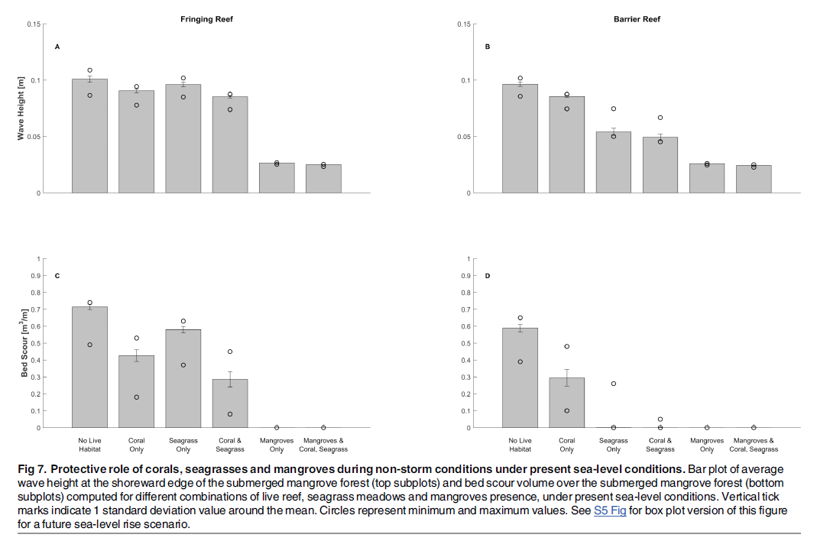
Mangrove Forests
Mangrove forests live in the tropical and subtropical regions at the interface between terrestrial and marine environments (Koh et. Al, 2018). As a community, mangroves thrive in a wide range of harsh environmental conditions and they share unique adaptive traits such as salt-excreting leaves, an exposed breathing root system, and production of viviparous propagules (Duke, 1992). Mangrove habitats are ecologically important because they provide valuable ecosystem goods and services to coastal populations.
Guannel at al (2018)
Notes:
Mangrove forests live in the tropical and subtropical regions at the interface between terrestrial and marine environments (Koh, Teh, Kh'ng, & Raja Barizan, 2018). They are found within the intertidal zones of the tropics and subtropics between approximately 30° N and 30° S latitude (Long & Giri, Mapping the Philippines' Mangrove Forests Using Landsat Imagery, 2011). As a community, mangroves thrive in a wide range of harsh environmental conditions and they share unique adaptive traits such as salt-excreting leaves, an exposed breathing root system, and production of viviparous propagules (Duke, 1992). Mangrove habitats are ecologically important because they provide valuable ecosystem goods and services to coastal populations. For example, products such as firewood, alcohol, medicines, fish, and construction materials benefit coastal inhabitants (Brown and Fischer, 1918; Spalding, Blasco, and Field, 1997; Walters, 2005 as cited in Long et al., 2014). Additionally, unperturbed mangrove ecosystems provide bio-protection from coastal erosion, tropical storms, and tsunamis (Alongi, 2008; Giri et al., 2008; Naylor, Viles, and Carter, 2002 as cited in Long et al., 2014); offer suitable breeding and feeding sites for numerous aquatic and avian species (Ewel, Twilley, and Ong, 1998; Ronnback, 1999 as cited in Long et al., 2014); and are a major carbon sink (Donato et al., 2011; Ong, 1993 as cited in Long et al., 2014). Despite their ecological-economic values, around half of total global mangrove coverage has been lost since pre-industrial times (Giri et al. 2011). Mangrove forests are currently disappearing at an alarming annual rate of 1 to 2% globally (Long, Napton, Giri, & Graesser, 2013).
Investigate the individual and combined coastal protection services supplied by live corals on reefs, seagrass meadows and mangrove forests under present and future conditions.
It was found out that together, live corals, seagrasses and mangroves supply more protection services than any individual habitat or any combination of two habitats.

Slide 6
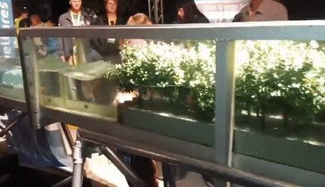
Notes:
Video from Nature Conservancy
https://www.nature.org/en-us/about-us/where-we-work/united-states/florida/stories-in-florida/why-mangroves-important/
https://www.google.com/imgres?imgurl=https%3A%2F%2Fthumbs.gfycat.com%2FFarawayFrailHermitcrab-size_restricted.gif&imgrefurl=https%3A%2F%2Fgfycat.com%2Ffarawayfrailhermitcrab&docid=fj7Ye_Nyoh32KM&tbnid=ioV6qcakzun5YM%3A&vet=1&w=435&h=250&bih=682&biw=1536&ved=2ahUKEwiShpTD26blAhUaa94KHXtNANoQxiAoAXoECAEQGQ&iact=c&ictx=1

Slide 7
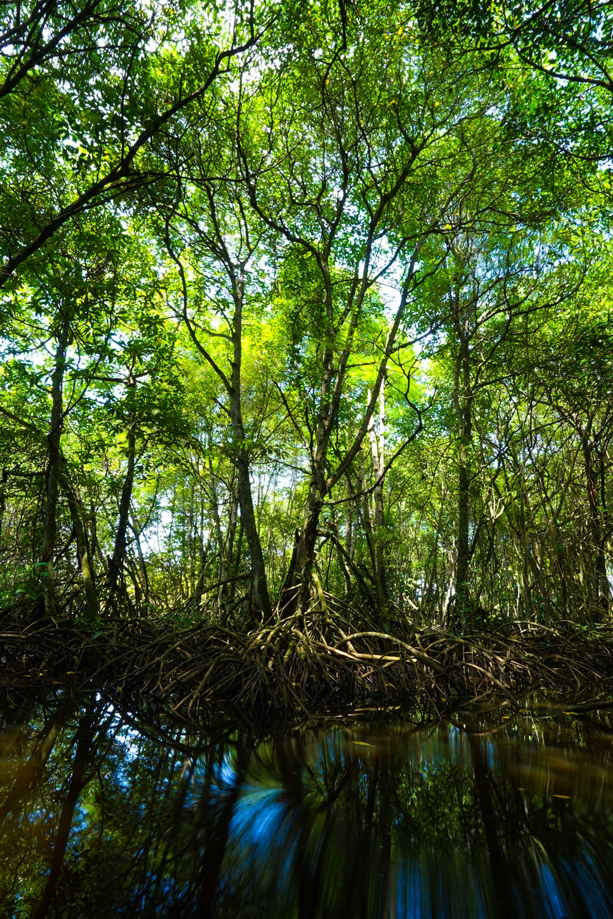
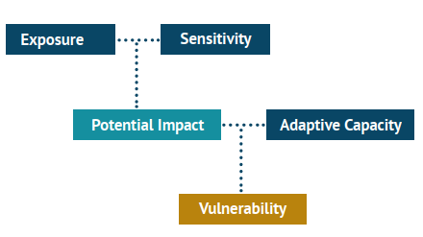
Exposure
Alino et al (2013)

Slide 8
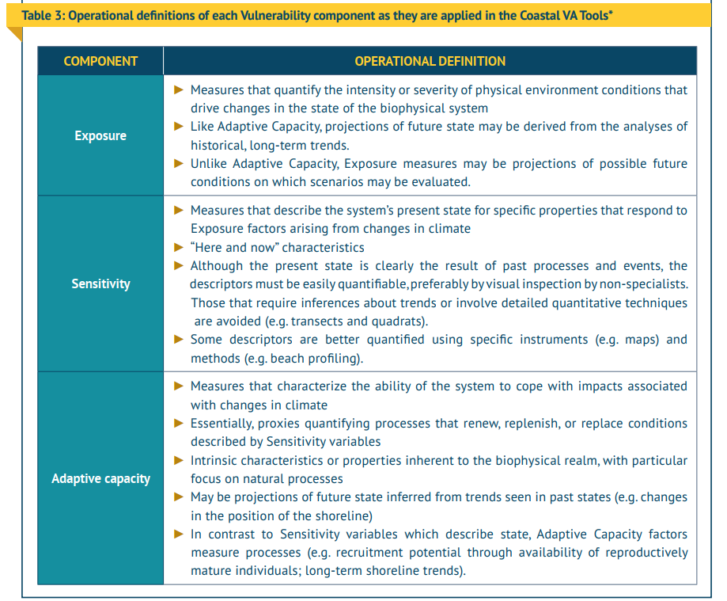
Exposure

Slide 9
Limitations
This project is focused on the mangrove forests located in Mactan Island and a few islets in Cordova.
The proposed indicators/criterions might be limited due to financial and time constraints of the project, however the replicability of the presented method should still accommodate if in case a new variable/criterion is introduced.
Notes:
Image Source
https://unsplash.com/photos/vtvwsA82aJE

Slide 10
Methodology
Hotels.com, 2019

Slide 11
Dataset
Temporal pattern
Physical environemnt
Others (basemaps)
Mangroves (1996)
Mangroves (2007)
Mangroves (2016)
Buildings
Aquaculture
Traffic
Roads
Seaports
Landsat (Basemap)
Municipal Boundary

Slide 12
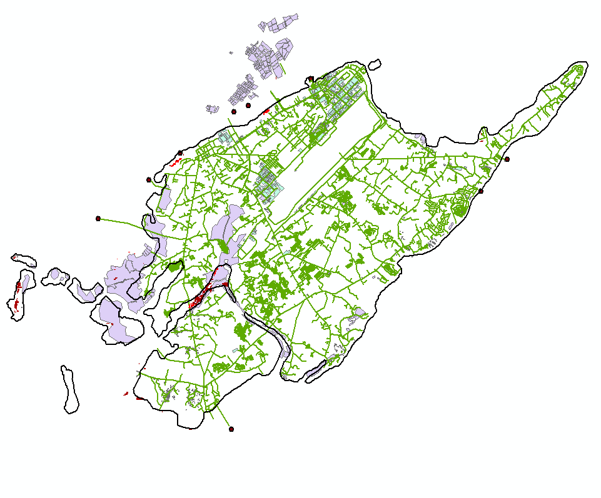
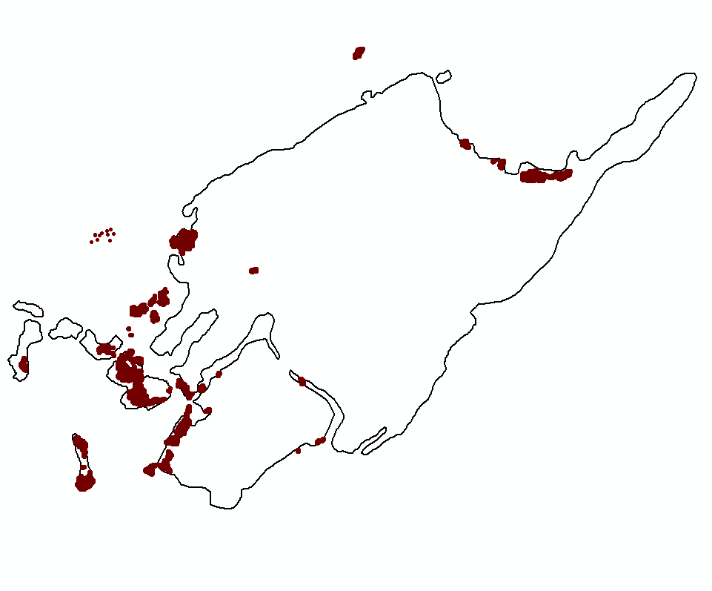
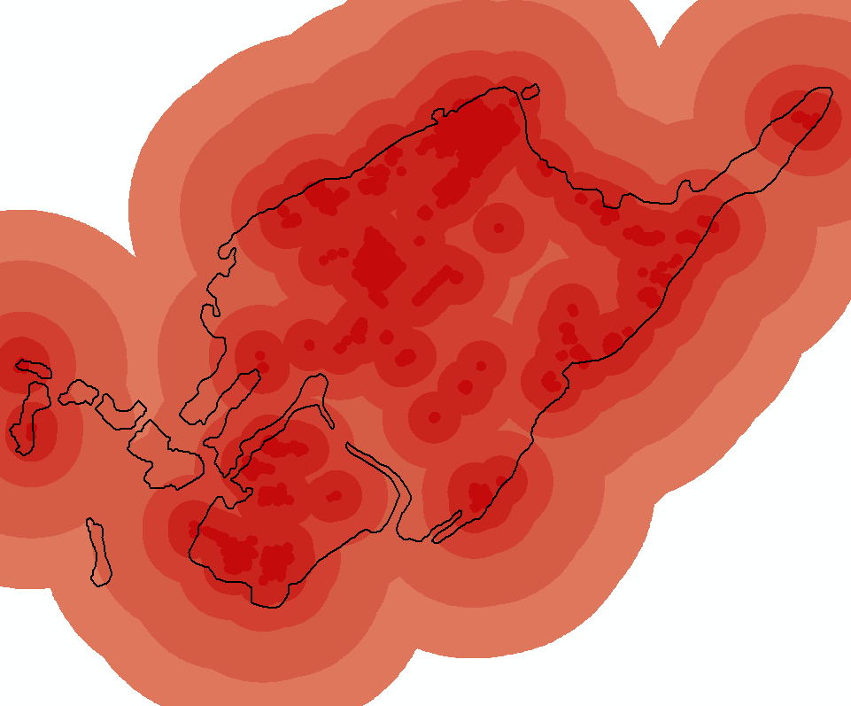
Methods
Data Analysis
Get
Mangrove Data
Buffer
Data
Get
Factors

Slide 13
Methods
Factors
Data Analysis

Slide 14
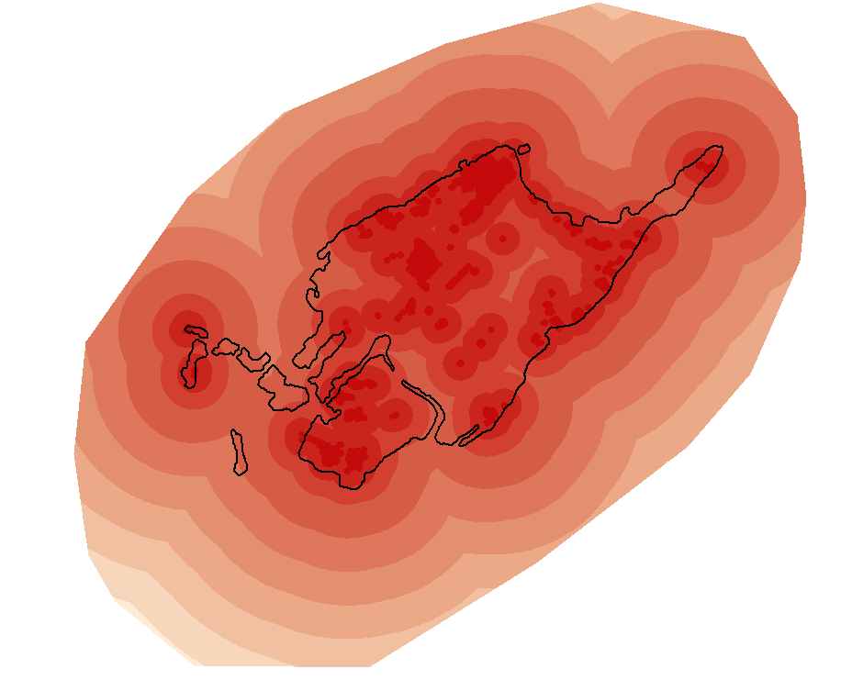
Buildings
Factors

Slide 15
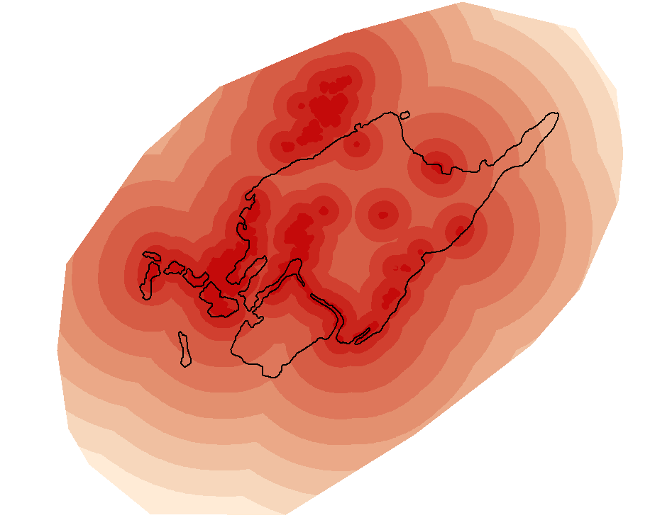
Fishpond
Factors

Slide 16
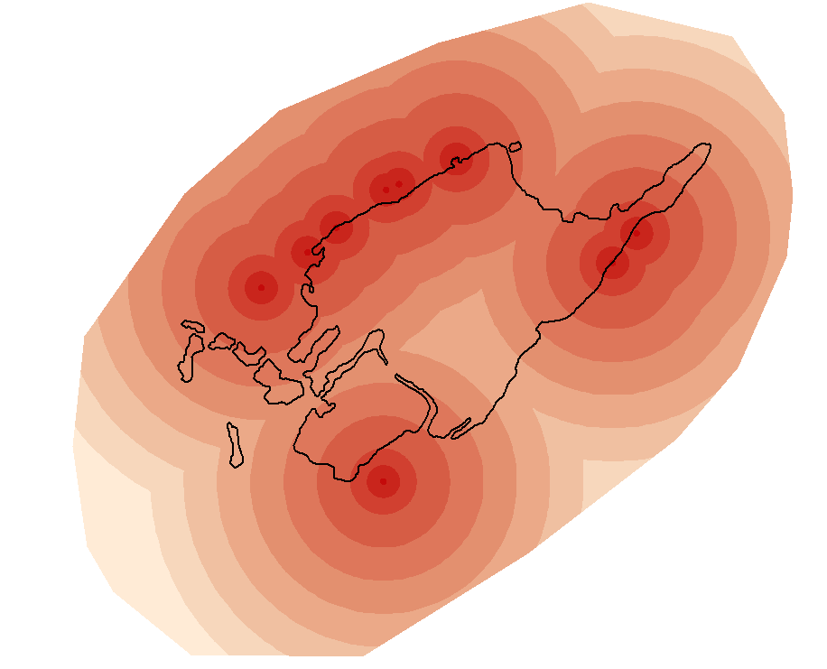
Seaports
Factors

Slide 17
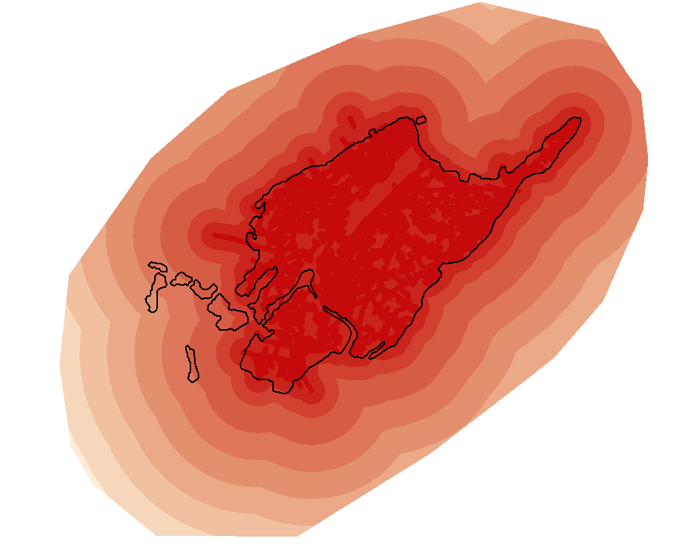
Roads
Factors

Slide 18
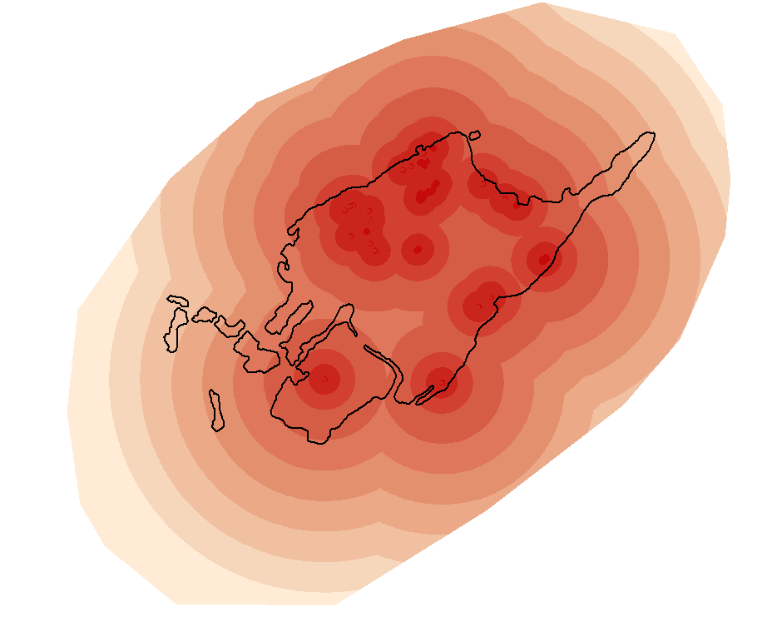
Traffic
Factors

Slide 19
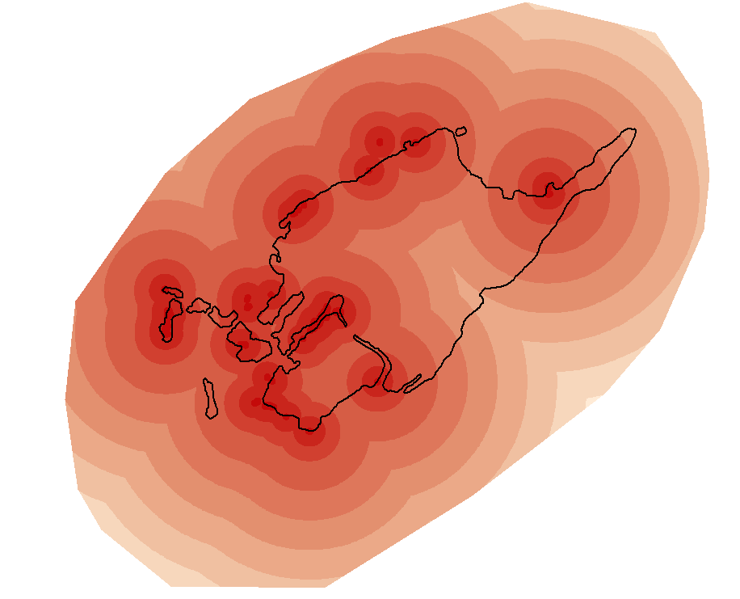
11 Year Loss
Factors

Slide 20
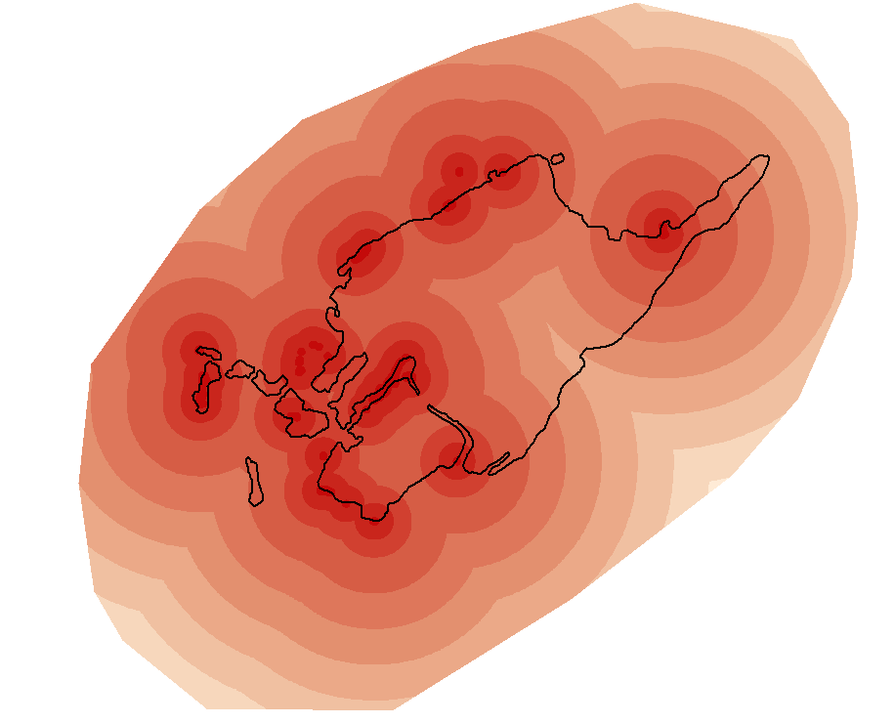
20 Year Loss
Factors

Slide 21
Methods
Data Analysis
Get
Mangrove Data
Buffer
Data
Get
Factors

Slide 22
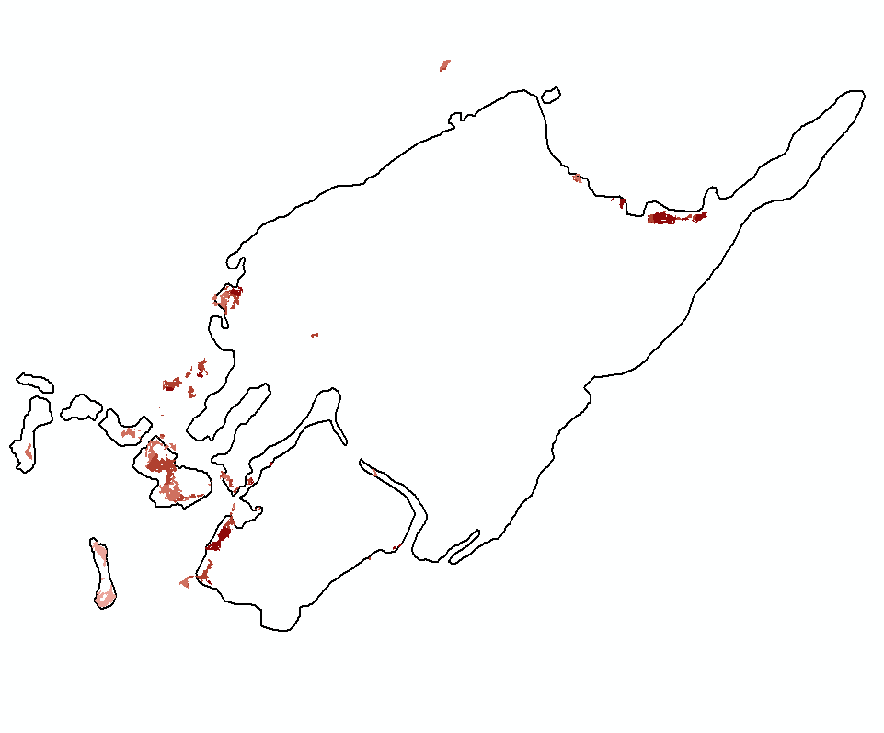
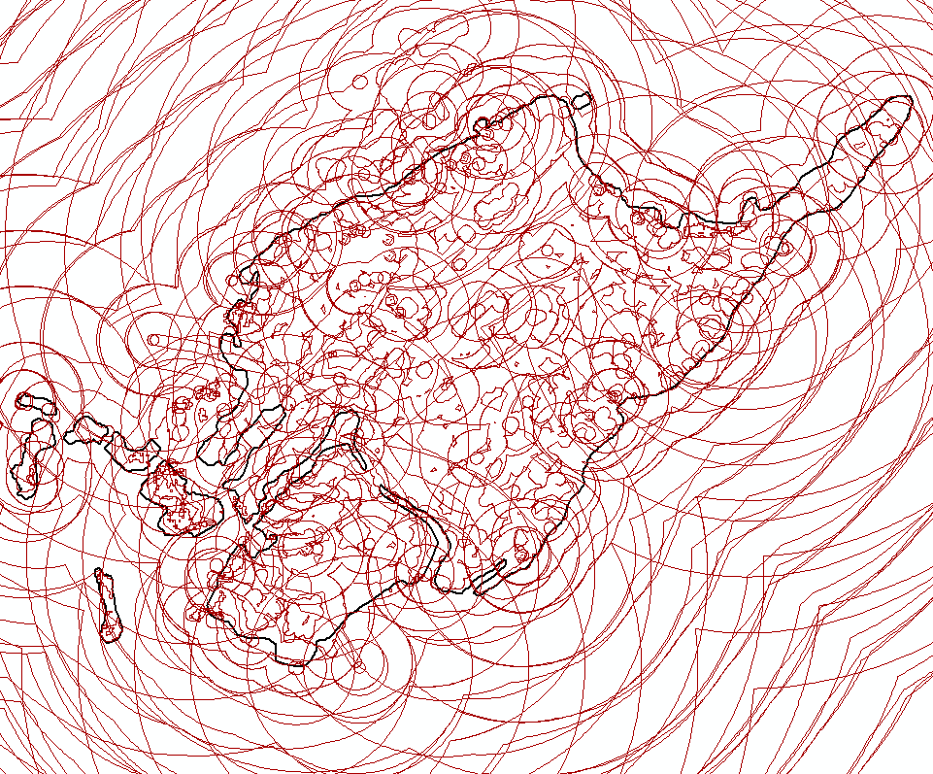
Perform
Union
Create
Map
Caculate
Exposure

Slide 23
Output

Slide 24
Significance
Helps the Local Government Units in Prioritization
Policy Making
Opens up further research on Mangrove Vulnerability
Aids in the fight against Climate Change
Helps Coastal Communities
Mangrove Ecosystem Protection

Slide 25

References
Journals
Alino, P.M, Follosco, N.M.G., Mamauag, S.S., Martinez, R.J.S., Panga, F.M., (2013). Vulnerability Assessment Tools for Coastal Ecosystems: A Guidebook. Marine Environment and Resources Foundation, Inc. Quezon City, Philippines
Guannel G, Arkema K, Ruggiero P, Verutes G. (2018). The Power of Three: Protect Coastal Regions and Increase Their Resilience. PLoS ONE. 2016;11(7):1-22. doi:10.1371/journal.pone.0158094
Koh, H. L., Teh, S. Y., Kh’ng, X. Y., & Raja Barizan, R. S. (2018). Mangrove Forests: Protection against and Resilience to Coastal Disturbances. Journal of Tropical Forest Science, 30(5), 446–460. https://doi.org/10.26525/jtfs2018.30.5.446460
Datasets
Mangrove Data for 1996, 2011 & 2016
……………………………….... Global Mangrove Watch
Buildings, Fishpond, Roads, Traffic
………………………………… Open Street Map (OSM)
Seaports
…………… Visual Inspection through Google Earth
Satellite Image and Basemap Image
……………………………………... USGS LandSat 8

Slide 26
Notes:
Image Source: Maxwell Ridgeway
https://unsplash.com/photos/LROuwFNy9h4

